Slide 1
Passenger Airline Recommendation
Data Science Method to Increase Airline Recommendations

Slide 2
Problem - Solution
Problem
Recommendations
As of 2020, there are over 5,000 passenger airlines throughout the world.
Recommendation can depend on a range of facilities provided by the airline including seat comfort, food served, cabin staff, etc.
In this project, we understand and gain insights to which airline features most influence a general passenger’s recommendation.
We build a model to then predict a passenger’s recommendation using travel experience.

Slide 3
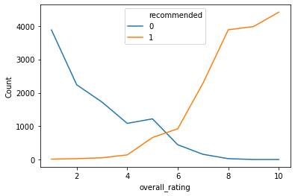
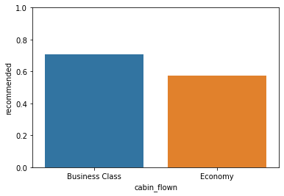
Analysis Plots
Rating vs Recommendation
Recommendation Breakdown

Slide 4
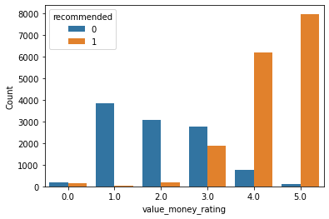
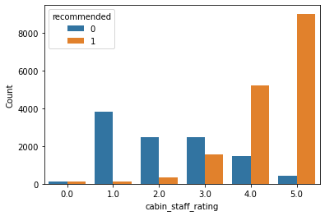
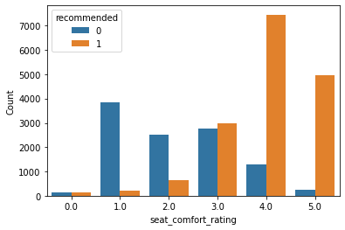
Analysis Plots - Features
Value for money
Cabin staff hospitality
Seat comfort

Slide 5
Summary
Business class passengers tend to recommend 14% more than Economy class passengers.
Inflight Entertainment is not very important for increasing airline recommendations.
Cabin Staff experience is quite sensitive, and only a perfect experience mostly leads to a positive recommendation.
We built a predictive model that can predict a passenger recommendation from his travel experience.

